Slide 1
DSC3013 Intro. to Social
Media Analytics (Lec. 7)
Hao PENG
Department of Data Science
City University of Hong Kong
https://haoopeng.github.io/

Slide 2
Learning objectives
By the end of this lecture, you will be able to:
- Distinguish between user profiling and behavioral analysis
- Formulate engagement prediction tasks and select appropriate features
- Explain adoption and retention as user lifecycle stages
- Describe how political polarization is measured from social media
- Understand user segmentation and personalization concepts
- Evaluate the ethical implications of behavioral prediction

Slide 3
Agenda for this week
Social media action analytics
  Actions reveal insights about behavior
User-level behavior
  Engagement prediction
  Change in user behavior
Community-level behavior
  Polarization
  Success / growth
  Collective action (e.g., OSM)
Personalization & Recommendation

Slide 4
From User Profiling to Behavioral Analysis
User profiling asked: Who is this user?
[Gender, age, ethnicity, personality, mental health, political affiliation]
Behavioral Q asks: What does this user do, and do next?
[Will they adopt, stay, engage, share, or churn, polarize, strike?]
Core distinction:
- Profiling predicts attributes (micro-level)
- Behavioral analysis predicts actions and dynamics

Slide 5
Why behavior matters
- Platforms optimize for engagement
- Advertisers buy predicted behavior, not just demographics
- Researchers study behavior to understand collective phenomena
- Regulators worry about behavioral manipulation and addiction
- Anything else? How can business owners benefit?
Notes:
Early Warning of Brand Risk
Behavioral signal: Spikes in negative sentiment, deletions, hostile replies, unfollows
Business benefit: Detect a crisis before it trends

Slide 6
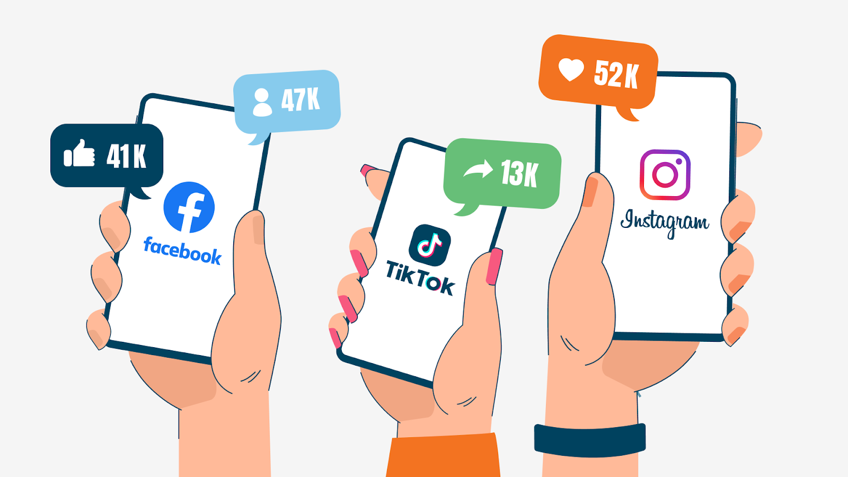
Action analytics
Social media actions analytics deals with extraction, analysis, and interpretation of insights contained in actions performed by social media users.
Actions on SM are easy and fast way to express feelings, unlike written reaction. They can be considered as social expressions and symbolic reactions to social media content.
Actions are the backbone of social media companies.

Slide 7
Common social media actions
Likes / Dislike
Share
Editing / Deleting
Visits, Revisits
Views
Clicks
Tagging
Mentions
(Un)follow
Check-in
Pinning / Bookmark
Blocking
Endorsement
Downloading
Notes:
Endorsement is a features of social media that lets people endorse and approve other people, products, and services.

Slide 8
Common social media actions
Mentions
  Mentions or social mentions are the occurrence of a person, place, or thing over social media by name.
  Mentions indicate popularity of person, product, place.
Check-in
  Check-in is a feature that allows users to announce and share their arrival at a location, such as a city, hotel.
  Rich check-in data can be mined to offer location-based services and products (good for travelers).

Slide 9
Common social media actions
Tagging / favorite
  Tagging is the act of assigning or linking extra pieces of information to social media content for identification, classification, and search purposes.
Pinning / collection
  Pinning is an action performed by social media users to pin and share interesting content (such as product, idea, services, and information) using a virtual pin-board.

Slide 10
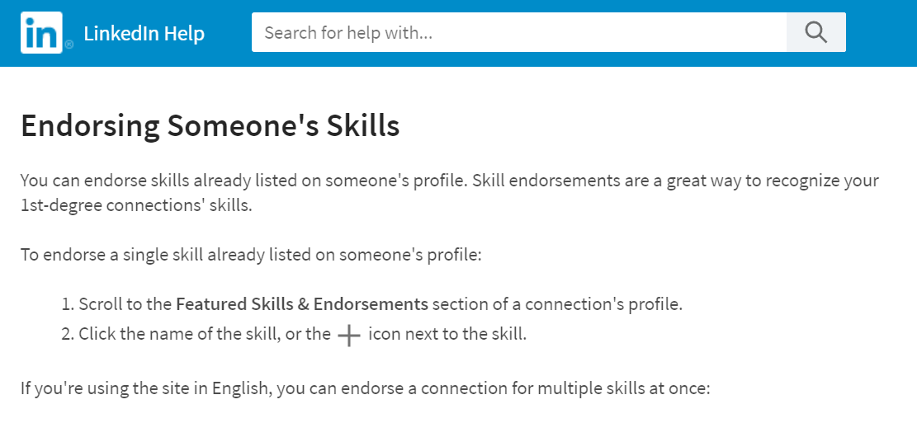
Common social media actions
Endorsement
  Endorsement is a features that lets people to endorse, rate, and approve other people, products, and services.
  Common types of endorsement: product reviews
Deleting / hiding / re-editing
  A good sign for user unsatisfaction, abandonment.

Slide 11
Macro-level behavioral analysis
The study of large-scale patterns, trends, and dynamics in user behavior, interests, and communities across online platforms.
It leverages big data to understand individual or collective behaviors, their evolving interests, and group dynamics within populations. They can be used to inform strategies at a platform or societal level.
Individual user behavior
  Adoption, retention (or churn), and engagement prediction.
  User evolution: how user interests (e.g., topics, hashtags) & behavior evolve over time, influenced by events, trends, or cultural shifts.
Community behavior
  The formation, growth, and dynamics of user communities based on shared interests, affiliations, or interactions. It examines how users cluster into groups and how these groups change.

Slide 12
What is User Adoption?
Definition:
The process by which a user starts using a feature, product, or platform.
In social media: Adopting a new feature (Reels, Stories), platform (Threads, Bluesky), or behavior (posting daily).

Slide 13
What is Retention?
Definition:
Continued use of a platform, feature, or behavior. Its opposite is churn.
Common retention windows:
- D1: returned the next day
- D7: returned within a week
- D30: returned within a month
Why retention matters:
Acquiring users is expensive; retaining them drives long-term value.

Slide 14
Adoption prediction task
Question: Will this user adopt feature X in the next 30 days?
Model: Logistic regression or gradient boosting
Features:
- Past feature adoption speed
- Engagement with similar features
- Network adoption (friends who adopted)
- Demographics and platform tenure
- Content type preferences
Metric: AUC, precision at high recall

Slide 15
Features for Adoption & Retention
Feature family
Example
Behavioral frequency
Sessions per week, posts per day
Behavioral trend
Slope of activity over 4 weeks
Network dynamics
New follows, lost follows
Content diversity
Number of distinct topics
Social feedback
Average likes, replies, mentions
Temporal recency
Days since last activity
Trend features are often more predictive than static features.

Slide 16
Engagement metrics
Platform
Common metrics
Facebook
Reactions, comments, shares, clicks
Instagram
Likes, saves, comments, story views
Twitter/X
Likes, retweets, replies, quote tweets
TikTok
Views, likes, comments, shares, watch time
Reddit
Upvotes, comments, awards
YouTube
Views, likes, comments, watch duration
Different platforms produce different behavioral signatures.
What about unique metrics on Redbook?
Notes:
Collections /

Slide 17
KPI metrics in SM ads industry
Reach: number of unique users who see the content
  E.g., A post seen by 10,000 unique users
Impressions: total number of times a post was displayed
  Same post can by viewed multiple times by the same person
Engagement: number of interactions
  E.g., Likes, comments, shares
Engagement rate: (Engagements / Reach) * 100
Click-Through Rate: Clicks / Impressions
Notes:
Metric icons.

Slide 18
Engagement prediction
Definition of Engagement:
Observable interaction between a user and a piece of online content such as likes, comments, shares, clicks, and time spent, etc.
Not the same as:
- Attention (not directly observable)
- Satisfaction (may diverge from engagement)
- Value (engagement metrics can mislead)
Engagement is multidimensional:
- a hundred likes are not the same as a thoughtful comment.
Can be used to measure popularity and influence, but not the quality of a product, service, or idea on social media.
Notes:
Beyond simple adoption / retention

Slide 19
Engagement prediction tasks
- Binary classification: Will this post receive high engagement?
- Count regression: How many likes will this post get?
- Ranking: Which of these 10 candidate posts will perform best?
- Time-series: How will engagement evolve over the first 24 hours?
- Comparative: Which post version (A/B) will engage more users?
Each task requires a different modeling approach.

Slide 20
Useful features
Four major feature families:
1. Content features - what the post says and shows
2. User features - who posted it
3. Temporal features - when it was posted
4. Network features - who is connected to the poster
Strong prediction usually combines all four and unique platform-specific features (depend on human insights).

Slide 21
Content-based features
Feature
Example
Text length
Character count, word count
Sentiment
Positive, negative, neutral
Emotional arousal
High-arousal language
Hashtags
Count, specificity
Mentions
Number of @mentions
Media type
Image, video, text-only
Readability
Grade level
Language style
Formal, informal, humorous

Slide 22
User & Network features
User features:
Network features:
- Follower count
- Account age
- Posting frequency
- Verified status
- Number of mutual follows
- Betweenness centrality
- Community membership
- Past interaction with audience
Who you are and who you follow shape engagement as much as what you post.

Slide 23
Temporal Features
- Hour of day: Engagement peaks vary by audience
- Day of week: Weekday vs. weekend patterns
- Recency: Newer posts get more attention
- Time since previous post: Posting frequency effects
- Event alignment: Election nights, disasters, holidays
Temporal features are cheap to compute and often useful.

Slide 24
Case - Predicting retweet count
Task: Predict retweets within 24 hours
Model: Negative Binomial Regression (overdispersed count)
Features:
- Hashtag count
- Sentiment polarity
- Follower count of user
- Contains URL
- Contains image
- Hour of posting
Evaluation: R², RMSE, AIC, deviance
Business use: Scheduling tools, influencer selection

Slide 25
Are there action analyses that go beyond engagement prediction?

Slide 26
Beyond Engagement: Content Deletion / Hide
Action analyzed:
Users deleting their own posts, comments, or replies.
Outcome Extraction
Analysis & Prediction
- Repeated snapshots
- API deletion signals
- Archive comparison
- Edit-history tracking
- Cross-referencing caches
- Deletion rate and time-to-deletion
- Sentiment of deleted posts
- Feedback before deletion
- Demographic differences
- Spikes around political events
Understanding mechanisms / Interpretation
Regret, self-censorship, impression management
Disproportionate cost of visibility for marginalized users
Collective responses to political or policy shifts
Engagement analyzes what users amplify.
Deletion and hiding analyze what users retract. (Both are useful)

Slide 27
Community-level Behavior

Slide 28
What is Political Polarization?
Definition:
Divergence of political attitudes, user identities, and behaviors among online users, with reduced interactions between groups.
Two types:
- Ideological polarization: Distance between issue positions
- Affective polarization: Dislike and distrust of the opposing group
Social media algorithms can amplify both types.

Slide 29
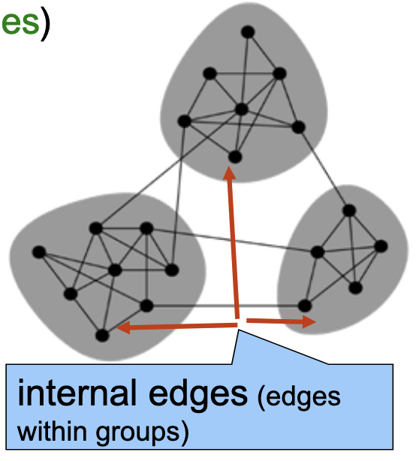
Key polarization metrics
Structure based:
  Network modularity: fraction of edges that fall within communities minus the expected fraction if edges were distributed at random.
  Edge density ratio: num. of edges (within / between)
  Assortativity: the degree to which nodes of similar attributes (ideology, gender, etc.) interact with each other, relative to random chance.
Content / interaction based:
  Opinion variance among group members
    Ideological preference
    Sentiment, morality, etc.
    [Can use Gini index to measure it]
  Cross-community interaction
    replies, mentions, etc
    Ratio of in-group to out-group interactions

Slide 30
Case - Polarization on Twitter/X
Task: Measure polarization in U.S. political discussion.
Data: Tweets with political hashtags (e.g., #Election2024)
Method:
- Build retweet network
- Detect communities (Louvain algorithm)
- Compute modularity
- Measure cross-community retweet rate
- Track metrics over time
Finding: Modularity increased; cross-community retweets declined.
Interpretation: Users increasingly stayed within ideological clusters.

Slide 31
Echo chambers online
Echo chamber in social media refers to an environment where users are primarily exposed to content, opinions, and information that align with their existing beliefs.
How it forms:
Algorithms prioritizing content with high engagement
User behavior: people tend to follow, friend, and join groups with like-minded individuals (homophily).
Network effects: online communities (e.g., subreddits) amplify shared narratives due to social influence.

Slide 32
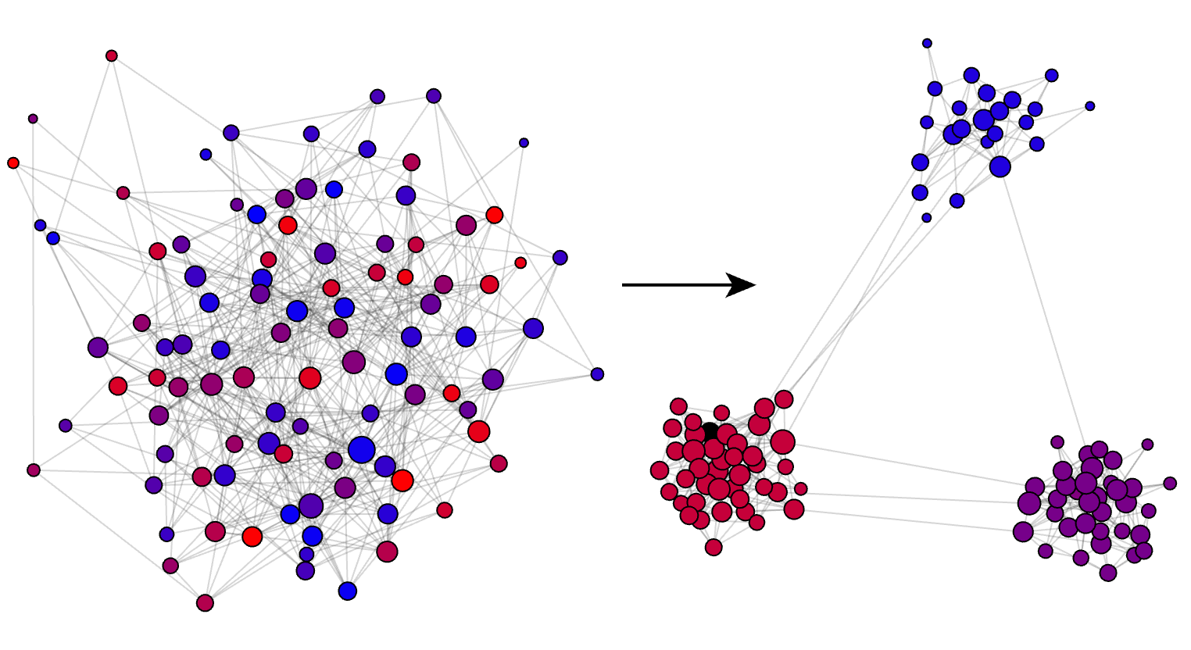

Simulating echo chambers
An interactive visualization on formation of Echo Chambers.
When influencing and unfriending are strong / often:
The total num of “subgroups” depends on user tolerance level.
Notes:
the network quickly converges into two or more segregated and homogeneous echo-chambers

Slide 33

Mitigation strategies
How to break out of Echo Chambers:
Diversify your feed: Follow credible accounts with opposing views (e.g., @nytimes and @foxnews).
Use platform tools: Turn off personalized recommendations.
Seek primary sources: Read original studies instead of opinion posts. Make your own judgement with critical thinking.
Recall “parable of polygons” in DSC 2005: diversity matters!

Slide 34
Echo Chambers vs. Filter Bubbles
Echo chamber: A social network where users primarily interact with like-minded others with similar opinions.
Filter bubble: Algorithmic curation on online platforms that limits user exposure to opposing views and information.
Distinction:
- Echo chambers are user-driven (homophily)
- Filter bubbles are algorithm-driven (ranking, recommendation)
- Both reduce exposure to diverse opinions, but via different mechanisms.
Trade-off: Engagement may drop when polarization is reduced.

Slide 35
Personalization
User segmentation: dividing users into groups based on their demographics, behavior, or preference for marketing strategy.
Content recommendation: Building intelligent systems to recommend content and products tailored to individual users.
Goals:
- Increase relevance
- Improve user experience
- Drive engagement & retention
Risks:
- Filter bubbles
- Privacy concerns
- Manipulation & addiction

Slide 36
User segmentation
Linguistic methods:
Cluster users based on their linguistic features
  BoW, TF-IDF, LIWC, LDA, etc.
Obtain user embeddings based on post vectors
  Average word embeddings of user posts
  Learn user vectors directly from doc2vec (how?)
Network-based methods:
Node2vec: do random walks on social networks and train the word2vec model on the sampled trajectories of users (words).
  Different ways to build a network
  More details in future lecture on SNA

Slide 37
Content-based Filtering
Idea: Recommend items similar to what a user has liked before, based on some measurable / observable item features.
Item features:
- Text topics (from LDA, embeddings)
- Media type (image, video, verified, etc.)
- Author (new vs. old, gender, etc.)
- Hashtags (unique hashtags contained)
Strengths: Explainable, can just use item metadata
Weaknesses: Limited serendipity; recommends only familiar content
Classic example: Spotify's music recommendation algorithm

Slide 38
Collaborative Filtering
Idea: Use the behavior of similar users to recommend items.
Two steps:
Find users similar to you
recommend what they liked
Strengths: Works well with large datasets
Weaknesses: Cold-start problem, popularity bias
Classic example: Amazon's customers who bought this also bought...

Slide 39
Hybrid recommendation system
Hybrid approaches combine:
- Content-based filtering for cold-start
- Collaborative filtering for personalization
- Add contextual features (time, device, location)
Evaluation metrics:
- Precision@k, Recall@k
- NDCG (ranking quality)
- Click-through rate (CTR)
- Diversity, novelty, serendipity
- Long-term satisfaction vs. short-term engagement
Key tension: Optimizing clicks may reduce diversity and well-being.

Slide 40
Discussion Questions
1. Should platforms optimize for engagement if it hurts well-being?
2. How would you design an ethical recommendation system?
3. Can polarization be measured without users' ideology?
4. When does personalization become manipulation?
5. How would you explain churn prediction to a product manager?

Slide 41
Course notes
HW1 released
  Due on Oct 16 (end of day).
Social network analysis next week
Tutorial 4
  Behavior analysis, community polarization

